Slide 1
Digital Portfolio
STUDENT NAME: yuvaraj
REGISTER NO AND NMID:asunm1112401111058058
DEPARTMENT: computer science
COLLEGE: L.N.Government college, Madras University.

Slide 2
PROJECT TITLE
Digital portfolio using front end web development

Slide 3


AGENDA
Problem Statement
Project Overview
End Users
Tools and Technologies
Portfolio design and Layout
Features and Functionality
Results and Screenshots
Conclusion
Github Link
3/21/2024 Annual Review

Slide 4

PROBLEM STATEMENT
STUDENTS AND BEGINNERS IN WEB ENGINEERING FTEN LACK A SIMPLE, PROFESSIONAL WAY TO PRESENT THEIR SKILLS, PROJECTS, AND ACHIEVEMENTS ONLINE. WITHOUT A PORTFOLIO, IT BECOMES DIFFICULT FOR RECRUITERS, TEACHERS, AND COLLABORATORS T ASSESS THEIR CAPABILITIES QUICKLY.

Slide 5

PROJECT OVERVIEW
THIS PORTFOLIO WEBSITE FOR YUVARAJ M IS A RESPONSIVE, INTERACTIVE WEB APPLICATION BUILT USING HTML, CSS, AND JAVASCRIPT. IT HIGHLIGHTS PERSONAL DETAILS, PROJECTS RELATED TO WEB ENGINEERING, AND A CONTACT FORM FOR COMMUNICATION. THE WEBSITE IS DESIGNED TO BE MOBILE-FRIENDLY AND VISUALLY APPEALING.

Slide 6

WHO ARE THE END USERS?
STUDENTS/FRESHERS PROJECTS. TO SHOWCASE SKILLS ANDRECRUITERS/EMPLOYERS TO EVALUATE CANDIDATE'S TECHNICAL ABILITIES.TEACHERS/MENTORS PROGRESS. TO ASSESS STUDENTCOLLABORATORS/PEERS PROJECT WORK. TO CONNECT AND SHARE

Slide 7

TOOLS AND TECHNIQUES
LANGUAGES: HTML5, CSS3, JAVASCRIPT ES6.TECHNIQUES: RESPONSIVE DESIGN, GRID & FLEXBOX LAYOUT, CSS TRANSITIONS, AND DOM MANIPULATION FOR INTERACTIVITY.ENVIRONMENT: VS CODE (IDE), MODERN WEB BROWSERS FOR TESTING.

Slide 8
POTFOLIO DESIGN AND LAYOUT
NAVBAR PROVIDES EASY NAVIGATION ACROSS SECTIONS.HER SECTION INTRODUCES THE PORTFOLIO WNER WITH A CALL-T-ACTION BUTTON.ABOUT SECTION DISPLAYS PROFILE IMAGE AND SHORT BIOGRAPHY.PROJECTS SECTION SHOWCASES WEB ENGINEERING PROJECTS IN GRID LAYOUT.CONTACT SECTION COMMUNICATION. INTERACTIVE FORM FORFOOTER COPYRIGHT DETAILS.
8

Slide 9
FEATURES AND FUNCTIONALITY
FULLY RESPONSIVE DESIGN (WORKS ON DESKTOP AND MOBILE).ANIMATED PROJECT CARDS (HØVER EFFECTS).INTERACTIVE CONTACT FORM WITH VALIDATION.MOBILE MENU TOGGLE (HAMBURGER NAVIGATION).SMOOTH SCROLLING BETWEEN SECTIONS.

Slide 10
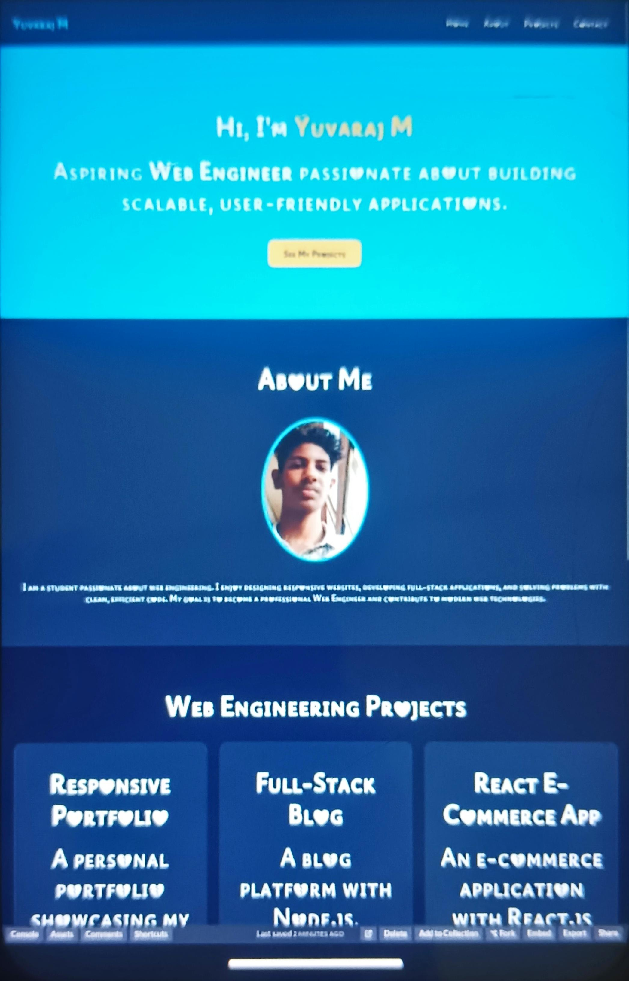
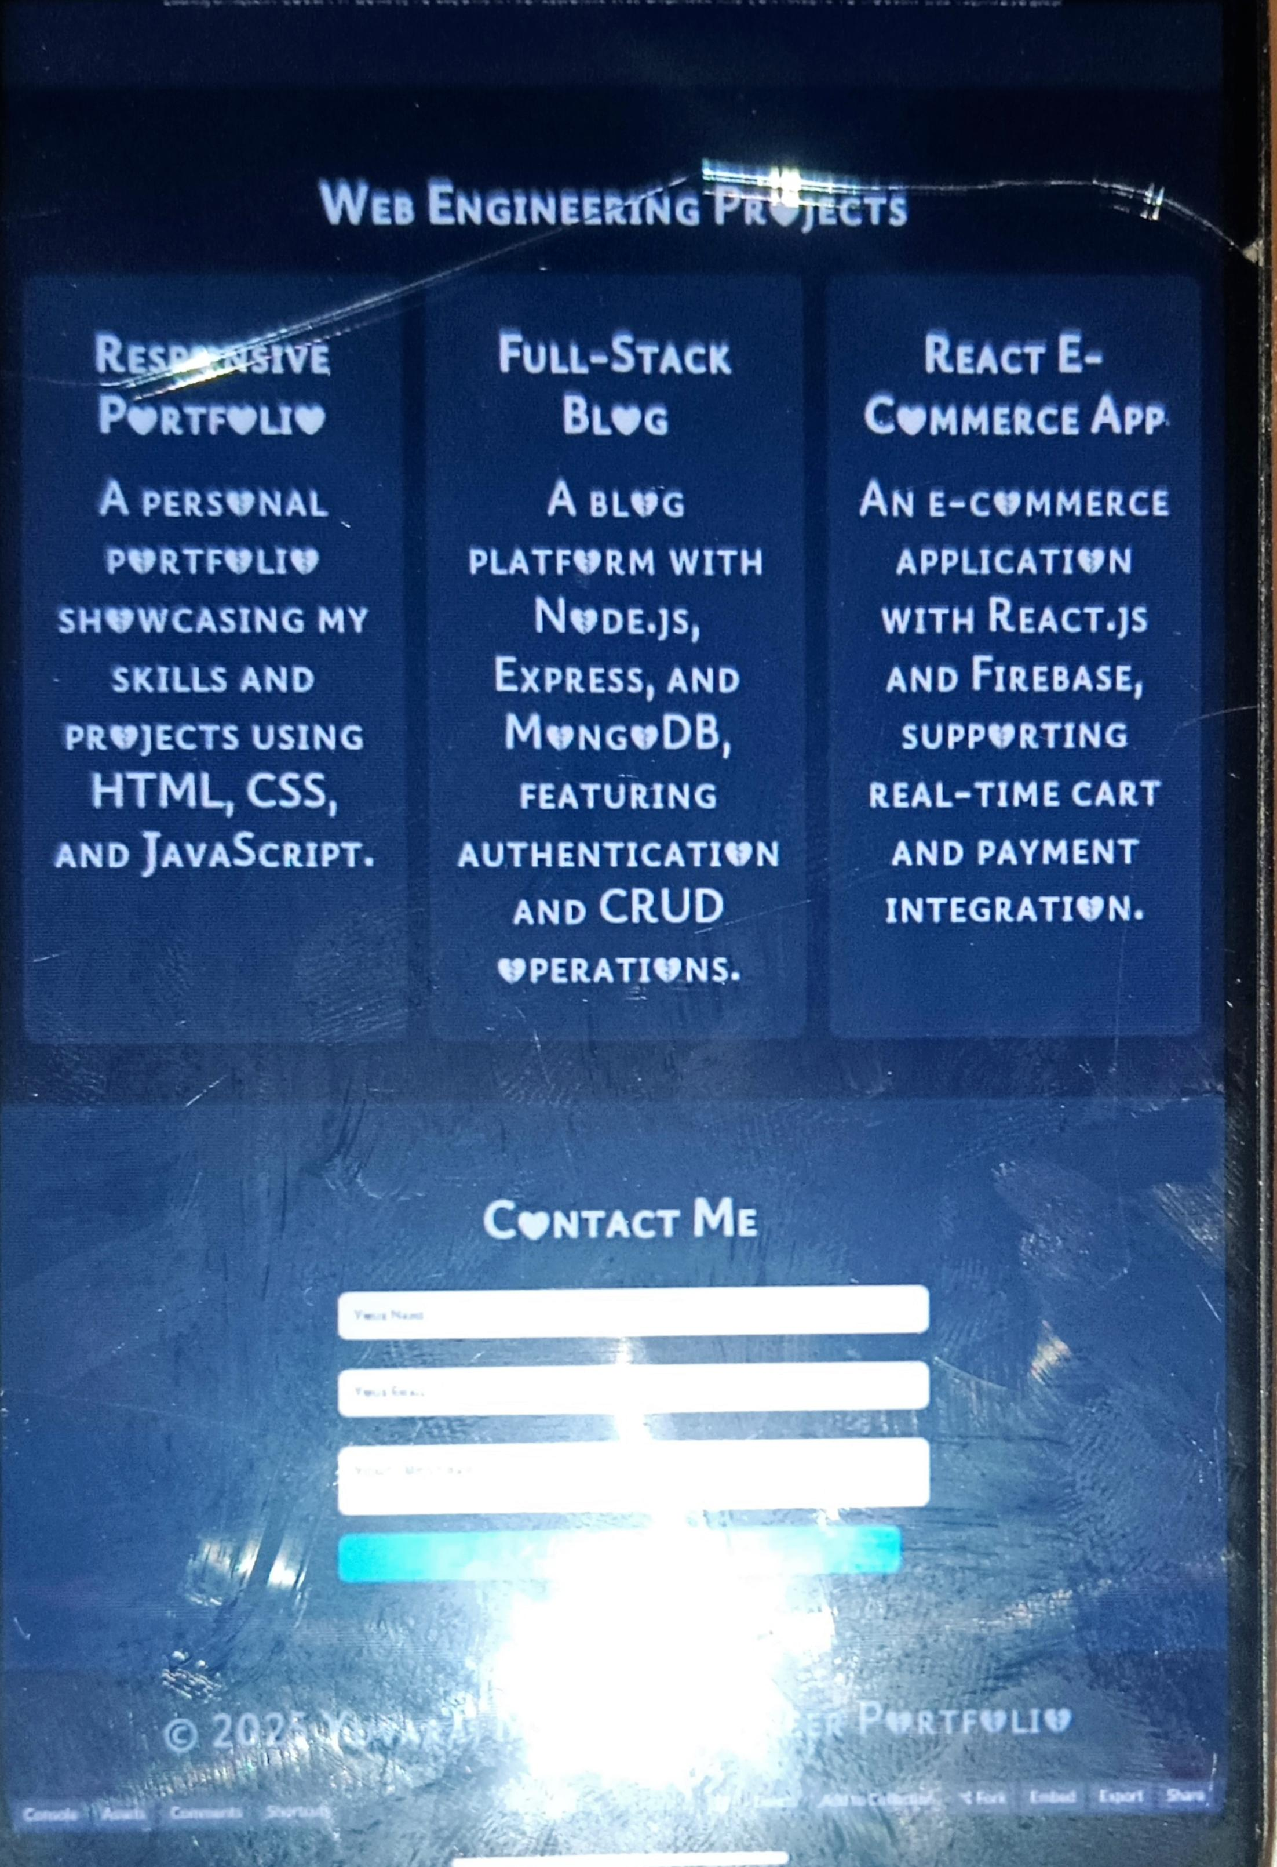
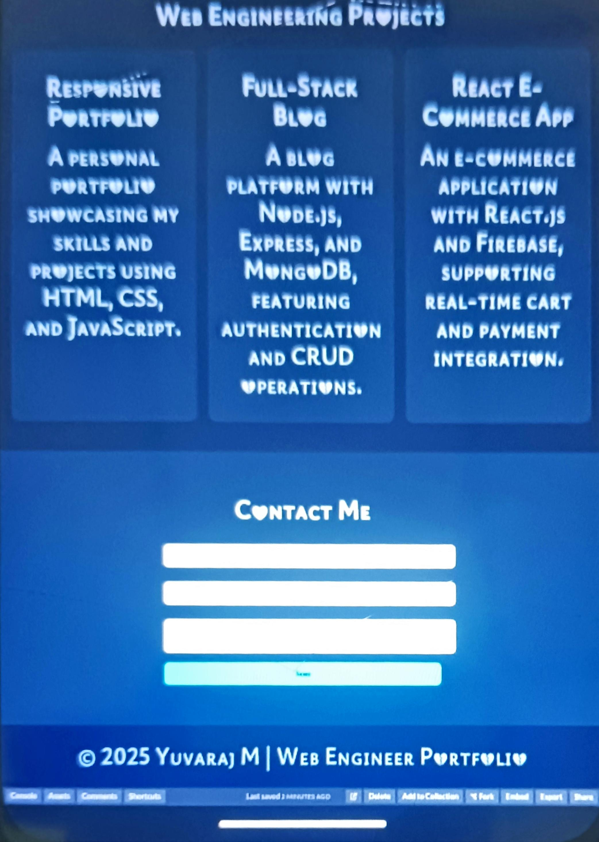

RESULTS AND SCREENSHOTS
3/21/2024 Annual Review
10

Slide 11
CONCLUSION
THE PORTFOLIO PROVIDES A PROFESSIONAL ONLINE PRESENCE FOR YUVARAJ MAS AN ASPIRING WEB ENGINEER. IT IS WELL-STRUCTURED, VISUALLY MODERN, AND USER-FRIENDLY, MAKING IT USEFUL FOR STUDENTS, RECRUITERS, AND COLLABORATORS. THE SITE CAN BE FURTHER EXPANDED WITH A BACKEND FOR STORING CONTACT FORM SUBMISSIONS OR SHOWCASING LIVE PROJECT DEMS.
11

Slide 12
Github link
https://yuvarajdeena0-oss.github.io/TNSDC-FWD-DP/

